Slide 1
Ethics in Pharmaceutical Sales
Marc Le Menestrel
Associate Professor, UPF, Barcelona
Visiting Professor of Ethics, INSEAD marc.lemenestrel@upf.edu - marc.lemenestrel@insead.edu
Notes:
Quote Poincarre
Balance: questions, opinions, jugements
Niveau d’enseignement pour les top managers

Slide 2
Thinking Ethics as a Grey Zone
Looking at the bad side
Looking at the good side
You feel good, full of energy
You may not be as credible as you want
And you may be blind to risks
You are honest
It feels bad
But you are more aware and anticipate
Purely
unethical
Purely
ethical
Ethics is a dialetheic concept: most actions if not all are both ethical and unethical
Our ethical judgments are bounded and biased by our emotions, our self-interest, our mental habits and self-image, our cultural context, our work environment and our power to act.
This phenomenon is not necessarily intentional, but it can have significant consequences.
We can develop, refine and structure our ethical consciousness. It requires to open our mind and be able to think beyond the justification of your ethical opinion.
It necessitates training and effort, outside our zone of comfort
Marc Le Menestrel, UPF & INSEAD, for

Slide 3
Enlightening your Ethical Blindspot
To which extent is this unethical?
To which extent is this ethical?
Which stakeholders can be harmed? How much? When?
Can this be wrong? Against compliance? Against to law? Against some ethical principle? If everyone does the same? All the time?
Am I having bad feelings? A sense of discomfort? An early warning signal inside?
Would this be better kept secret? Is this taboo? Could it be publicly known?
Which stakeholders can benefit? How much? When?
Is this right? Does it comply? Is this legal? Is this respecting ethical principles, code of values? Can this be universalized?
What good feelings do I have? What virtue do I incarnate? Why is this respecting my personal integrity?
What would I like to be known? To be transparent? is transparent?
Here, you face the dilemma
Here, you justify your interest

Slide 4
Ethical Rationality is Open
Ethical Values
Less ethical
More Ethical
Priority
to
interest
Better
Ideal
Interest
Priority
to
ethics
Worse
Irrational
Rational choices between interest and ethics are often kept hidden, but they are the most difficult:
We can rationally give priority to interest, and sacrifice ethics
We can rationally give priority to ethics, and sacrifice interest
Marc Le Menestrel, UPF & INSEAD, for

Slide 5
Blue Monday
As Alex, what would you do?
Why?

Slide 6
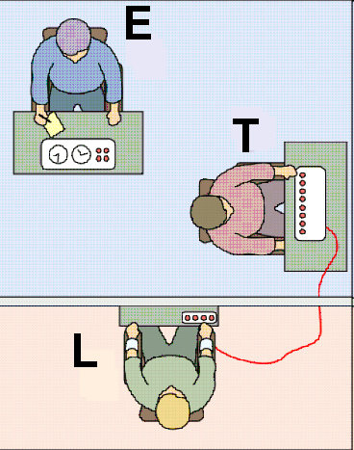
Milgram experiment
The Experimenter (E) persuades the “Teacher” Participant (T) to give what the Teacher Participant believes are painful electric shocks to another “Learner” Participant (L), who is actually an actor.

Slide 7
The Hoax
The “Teacher” Participant T was told to be a “Teacher”
and was given a list of word pairs which
he was to teach to the “Learner” L (the actor).
The Teacher begins by reading the list of word pairs to the Learner. The Teacher would then read the first word of each pair and read four possible answers.
The learner would press a button to indicate his response.
If the answer was incorrect, the Teacher would give the Learner a shock, with the voltage increasing with each wrong answer.
If correct, the Teacher would read the next word pair.

Slide 8
Imposing Obedience
If at any time the subject (The Teacher T) indicated his desire to halt the experiment, he was given a succession of verbal prods by the experimenter, in this order:
“Please continue”.
“The experiment requires that you continue”.
“It is absolutely essential that you continue”.
“You have no other choice, you must go on”.
If the subject still wished to stop after all four successive verbal prods, the experiment was halted. Otherwise, it was halted after the subject had given the maximum 450-volt shock three times in succession

Slide 9
What were the results?
Voltage Indication
Slight Shock (15V-60V)
Moderate Shock (75V-120V)
Strong Shock (135V-180V)
Very Strong Shock (195V-240V)
Intense Shock (255V-300V*)
Extreme Intensity Shock (315V-360V)
Danger: Severe Shock (375V-420V)
XXX (435V-450V)
# of subjects for which the experiment was halted
0
0
0
0
5
8
1
26 (65%)
*After 300 Volt, the “victim” kicks on the wall and then no longer provides answers

Slide 10
From an observer
“I observed a mature and initially poised businessman enter the laboratory smiling and confident. Within 20 minutes he was reduced to a twitching, stuttering wreck, who was rapidly approaching nervous collapse. He constantly pull on his ear lobe, and twisted his hands. At one point he pushed his fist into his forehead and muttered ‘Oh God, let’s stop it’. And yet he continued to respond to every word of the experimenter, and obeyed to the end.”

Slide 11
Interpretation
“We have learned from childhood that it is a fundamental breach of moral conduct to hurt another person against his will. Yet, 26 subjects abandon this tenet in following the instructions of an authority who has no special powers to enforce his commands. To disobey would bring no material loss to the subject; no punishment would ensue.”
Stanley Milgram

Slide 12
Blue Monday(2)
Does a boss have a right to expect an employee to bend the rules?
What should you do when your boss (or colleague) seems to be asking you to compromise your own ethical principles?

Slide 13
Empowering Oneself
Describe for yourself who you tend to be when you fail to act upon your own values:
Describe for yourself who you tend to be when you succeed in acting upon your own values:

Slide 14
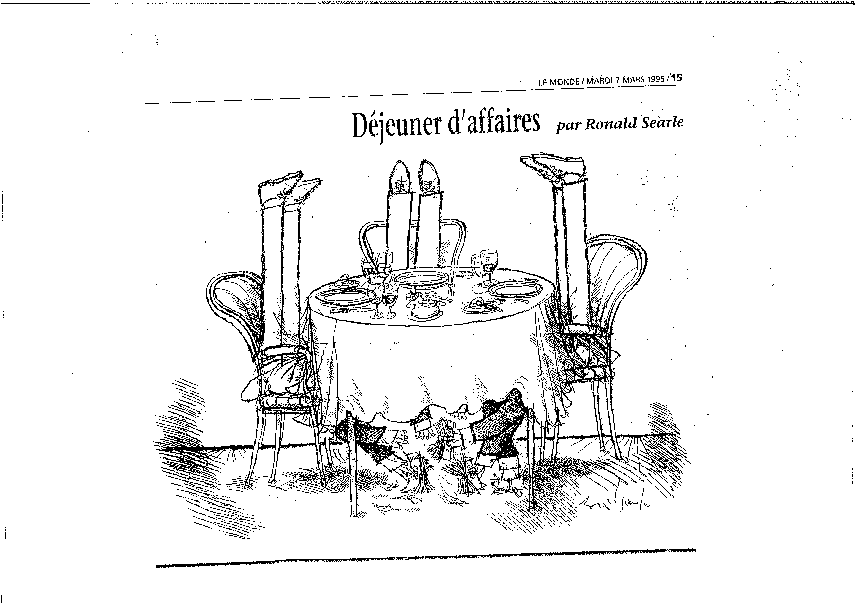

Slide 15
“Corruption”: Any Problem? (1)
It has always existed
It exists everywhere (in Europe, US, Japan, Developing Countries....)
It does not exist: it is a figment of the imagination, an invention of the West
It is a parallel income distribution system
Everyone does it
In this country, there is no alternative (if you want to do business)
It is very functional: it is the oil which makes the bureaucratic machine work
It is the tradition in this culture: a « norm of reciprocity »
I have no choice: if I do not do it, I will lose my job
Should they not ask for the money, I would be happy not to give it!

Slide 16
“Corruption”: Any Problem? (2)
Business is business
It is small, therefore it is OK
It is tax-deductible in my country: so, even for the government it is normal
I do not call it corruption: it is just a transaction cost
Given the competition: we have no choice
I do not do it, I have a Mr. Fix: he handles it very well
We have a budget for it, we have small pockets for that
You give a tip in your country, here they want a top: no difference
It really helps to get contracts, so I create jobs (at home)
My boss knows, but he does not want to know
It is a « win-win » solution

Slide 17
Some consequences (1)
Loss of Government revenue
Creates biases in decision-making processes
Nurtures “unfair” competition
Increases red tape costs
Delays project implementation
Increases the price of goods
Makes rules & regulations flexible

Slide 18
Some consequences (2)
De-motivates those who refuse to do it
Weakens the development process
Maintains incompetence of government
Encourages capital evasion
Deters some foreign investors
Creates political instability
Weakens the moral fiber of society

Slide 19
What can be done?
Nothing!
Something… but later!
I am not in charge
I have no lesson to give
The government has to do it
It is the job of International Organizations (e.g. UN agencies, World Bank, WTO, OECD, ICC, etc…)

Slide 20
Why Failing to be Ethical?
A “good”
consequence
?
Unethical
A “bad”
consequence
More Ethical
We fail to be Ethical because we believe it worths it and
We resist admitting the ethical issue (denial)
We insist on our good faith, spinning the ethical dimension (justification)
We have no choice and tend to blame others (externalization)
We face the ethical risks. In the worst case, we lose on both ethics and interest

Slide 21
Four quick “tests”
1. The “Sleeping test” :
  “if I do this, can I sleep well at night?
2. The “Newspaper Test”:
  “If it wouldn't look right on the front page of your daily newspaper, it probably isn't quite right”
3. The “Mirror test” :
  “If I do this, can I feel comfortable with myself when facing my mirror?”
4. The “Teenager test” :
  “If I do this, would I mind telling my 16 years old son about it?”

Slide 22
Why resisting?
A “good”
consequence
?
Unethical
A “bad”
consequence
?
More Ethical
We resist the Slippery Slope of Unethical behavior because we stand for our values and are able to convince others of an opportunity:
  We acknowledge the ethical dimension (Awareness)
  We anticipate the ethical risks (Prudence)
  We imagine an opportunity (Vision)
We may face economic risks. In the best case, we win on both ethics and interest

Slide 23
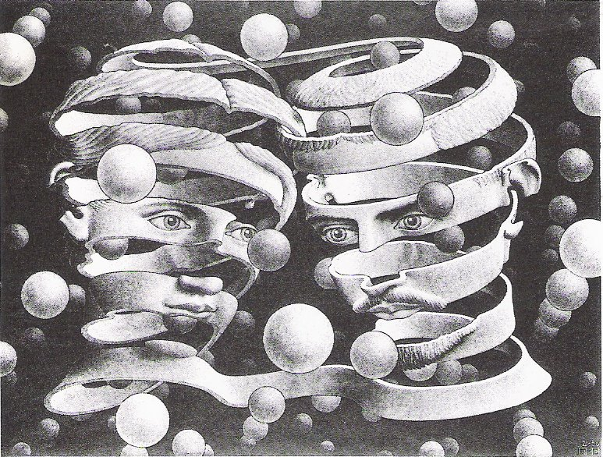

Slide 24

There will be no true success against who you truly are

Slide 25
